Slide 1



Slide 2

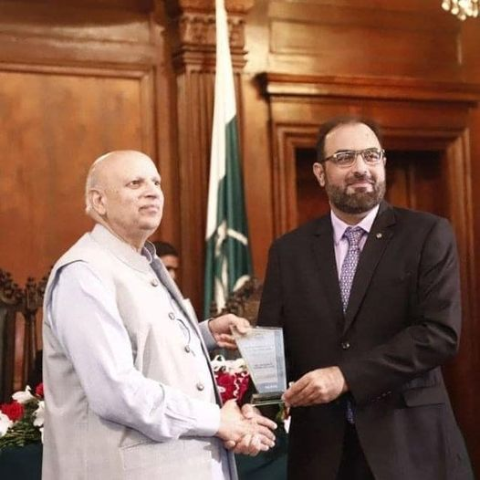
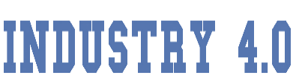




Assistant Professor|
In-charge Intelligent Machines and Robotics
Department of Computer Science, CUI Lahore
Co-founder, Chairperson
Neocog Pvt Ltd
Co-founder, Executive Director
eCOG(Pvt) Ltd
Co-founder, Executive Director
Quick Bee (Pvt) Ltd [in progress]
Consultant (AI & Robotics)
Arctan Engineering Solutions; Services Syndicate; MegaKart
Executive Director
Institute of Molecular Sciences & Bioinformatics
IEEE Lahore Section Treasurer
Founding Vice Chair IEEE RAS Pak Joint Chapter
In charge IEEE RAS CUI Lahore
Member Expert/Focus Group of Coordination Committee on AI & Robotics, Ministry of Science & Technology, Govt Pakistan
Member, Technology Foresight Committee for Robotics for Vision 2025, Pakistan Commission for Science & Technology, Govt of Pakistan
Invited to Prime Minster’s House, Governor House, Chief Minister House and Air Force (Kamra) ….
Member Evaluation Board of National Center for Artificial Intelligence, Pakistan
PPSC Govt of Punjab Ex-Exam-Paper Setter
Worked for NDC, Ministry of Defense
Dr. Wajahat M. Qazi
PhD (Machine Consciousness)
Asia Pacific United Nations Educational, Scientific and Cultural Organization (UNESCO) Committee on Ethic in Artificial Intelligence
Member Technical Committee, IEEE RAS Cognitive Robots

Slide 3
Evolutionary Computing
Introduction
Solution to Optimization problems inspired by biological evolution
Evolutionary hardware
Genetic Programming
Genetic Algorithms

Slide 4


Evolutionary Computing
Genetic Algorithms
Representations
Phenotype
Genotype
Real world Solution Space

Slide 5


Evolutionary Computing
Genetic Algorithms
Representations
Phenotype
Genotype
Real world Solution Space

Slide 6
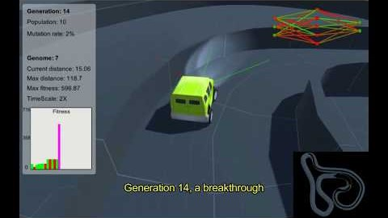
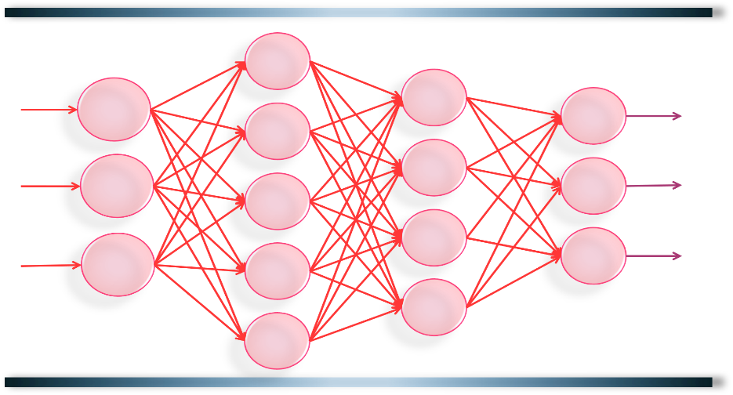
Evolutionary Computing
Genetic Algorithms
Representations
Phenotype
Genotype
Real world Solution Space

Slide 7
Evolutionary Computing
Genetic Algorithms
Working
Population
Fitness Eval…
Mating:
Applying Genetic Operation
Potential Parents

Slide 8
Evolutionary Computing
Genetic Algorithms
Genetic Operators: Crossover

Slide 9
Evolutionary Computing
Genetic Algorithms
Genetic Operators: Crossover

Slide 10
Evolutionary Computing
Genetic Algorithms
Genetic Operators: Crossover

Slide 11
Evolutionary Computing
Genetic Algorithms
Genetic Operators: Mutation

Slide 12
Evolutionary Computing
Genetic Algorithms
Crossover: Example
23
29
0
1
1
1
0
1
1
1
0
1
1
1
61
55

Slide 13
Evolutionary Computing
Genetic Algorithms
Mutation: Example
45
41
1
0
1
1
0
0
1

Slide 14

Evolutionary Computing
Genetic Algorithms
Original Population
New Population
Population
Population
Potential Parents
Potential Parents

Slide 15


